Slide 1
CRASH ERROR NEGLECT ALGORITHM A set of rules to detect the perfect crash and to neglect the noises being detected

Slide 2


INPUT = { --- h h h Acceleration in XYZ,
Speed
}
$$g=\frac{\sqrt{{a_{x}}^{2}+{a_{y}}^{2}+{a_{z}}^{2}}}{9.81}$$
G-FORCE >= 4g
(0 ≤ t ≤ 30)
∆SPEED < -20
(0 ≤ t ≤ 30)
SPEED < 5
OUTPUT = {
send notification
}
ONLY A SAMPLE ALGORITHM TO NEGLECT ERROR DETECTION. TO BE TESTED IF IT WORKS FINE.

Slide 3

STEP 1
STEP 2
STEP 3
The algorithm takes Three dimensional acceleration and Speed as input
g is calculated 20 times for every second
A threshold of 4g is set
Algorithm checks if the calculated g crosses the threshold
Whenever calculated g crosses the threshold of 4g, now to confirm vehicle is not moving, in next 30sec algorithm calculates ∆SPEED 20 times for every second
If ∆SPEED > -20, then vehicle may not be under any impact
If ∆SPEED < -20, then there may be a chance vehicle is under an impact
NOTE
Now to confirm if the vehicle is under an impact, SPEED of the vehicle is checked using the data in the same 30sec where ∆SPEED is calculated
If SPEED ≮ 5, then vehicle is not under any impact
If SPEED < 5, then vehicle must be under an impact according to our algorithm
Notification is sent
$$g=\frac{\sqrt{{a_{x}}^{2}+{a_{y}}^{2}+{a_{z}}^{2}}}{9.81}$$
If next bump in g value happens within 30 sec, where g > 4 then from that instant next 30 sec is taken
STEP 4
STEP 5

Slide 4
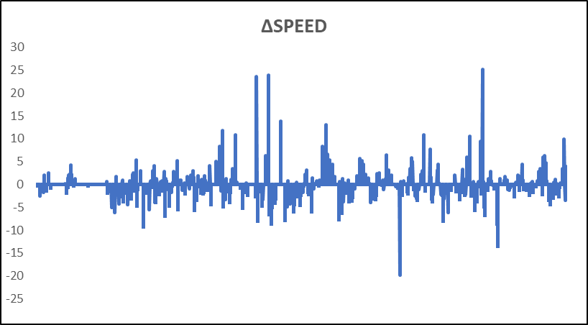
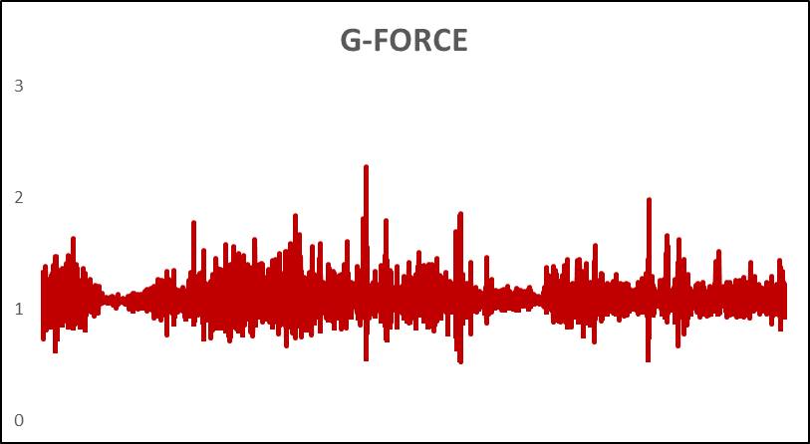
SAMPLE RIDE
Ride Number : 1131
Credentials : 8012120228
Password : User@123

Slide 5
POSSIBLE IMPROVEMENTS IN FUTURE
As soon as calculated g crosses the threshold, Microphone can be turned on and start to record the ambient sound for next 30sec
Later can be machine learned and detect if accident has really happened using audio signal processing etc or can be manually checked

